Slide 1
DOELAP Assessor Training Using the Checklist
Idaho Falls, ID
September 2024

Slide 2
DOELAP Radiobioassay Checklist
The checklist can be found in the email from Laird or at the RESL DOELAP web page
https://resl.id.energy.gov/doelap/doelap.html
Based on DOE-STD-1112-2019
The checklist is not a “normative” document
Findings are written based on Standard requirements
Checklist is a tool for the assessor
Personal checklists can also be used
Additional notes in another form or location are fine

Slide 3
DOELAP Radiobioassay Checklist
Portions of the checklist can be evaluated and filled out in advance
Assessment team sends in a completed checklist with the signed assessment report and attendance sheets
Defensibility if there are questions about whether something was evaluated
N/A column
Findings are written based on the Standard reference, not checklist
This wasn’t always the case in DOELAP, but is the guidance now
Findings database

Slide 4
Discussion on Checklist Use
How do assessors use the checklist?

Slide 5
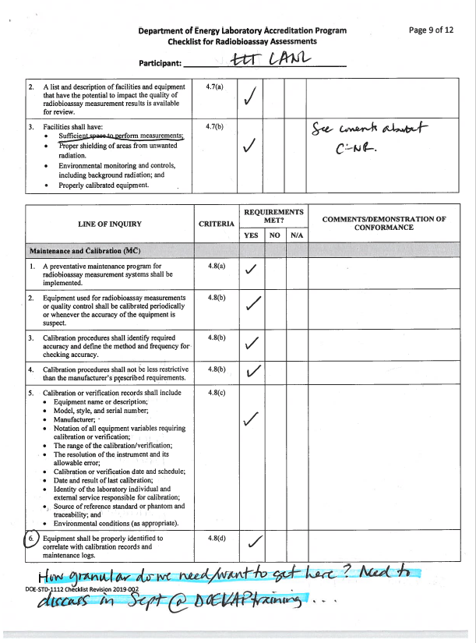
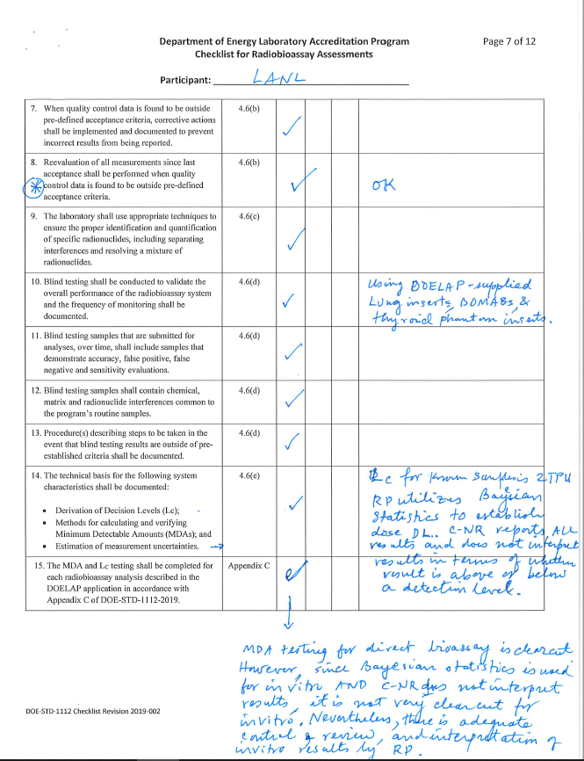

Slide 6
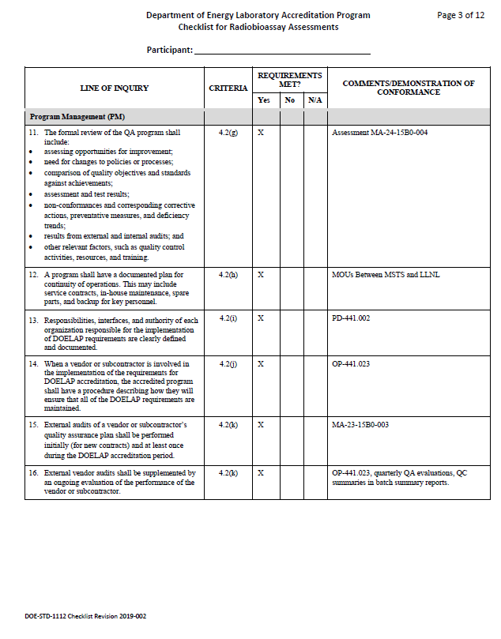
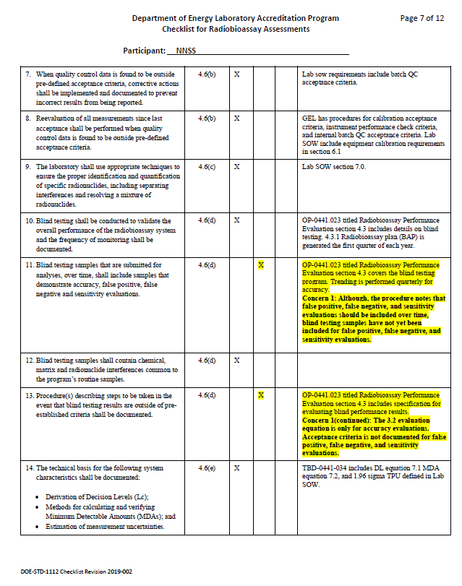

Slide 7
DOELAP Findings Database

Slide 8
Commonly Cited in Findings
(Quality Improvement) 4.6 (d) Blind testing shall be conducted to validate the overall performance of the radiobioassay system and the frequency of monitoring shall be documented. Blind testing samples that are submitted for analyses, over time, shall include samples that demonstrate accuracy, false positive, false negative and sensitivity evaluations. Blind testing samples shall contain chemical, matrix and radionuclide interferences common to the program’s routine samples. Procedures describing steps to be taken in the event that blind testing results are outside of pre-established criteria shall be documented.

Slide 9
Commonly Cited in Findings
(Documents and Records) 4.4 (b) All documents that form the quality assurance program shall be controlled to ensure that the correct documents are being employed. Documents shall be reviewed for accuracy and approved by authorized personnel in accordance with documented review frequencies.

Slide 10
The Checklist (current)
https://resl.id.energy.gov/doelap/doelap.html

Slide 11
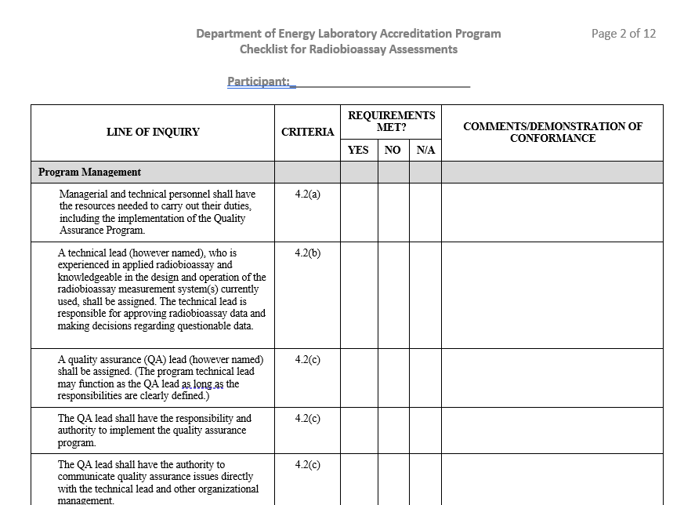
Revised Checklist
Removed line numbers and abbreviations

Slide 12
Questions?

